Slide 1
Heart Disease - Models
Rhichard Koh & Mohsin Mohammed

Slide 2
Project Overview
Heart disease is any disease that negatively affects the function of the heart.
The project analyzed a heart dataset to find patterns.
The patterns were used to build machine learning models.
The models are intended to predict whether a person has heart disease based on a few attributes.

Slide 3
Problem Statement
The goal is to create 5 machine learning models to predict heart disease.
One model will be a neural network and another an ensemble learning model.
Tasks include downloading and preprocessing data, exploratory data analysis, data visualizations, data cleaning, and identifying target class imbalance.
Model building and algorithm evaluation will also be performed.
Final models will be selected.

Slide 4
The Dataset
The heartdata.csv dataset contains 303 records with 14 attributes each.
It is widely used for research and analysis of heart disease.
The attributes include age, sex, chest pain type, resting blood pressure, serum cholesterol, fasting blood sugar, resting electrocardiographic results, maximum heart rate achieved during exercise, exercise-induced angina, oldpeak, slope of the peak exercise ST segment, number of major vessels colored by fluoroscopy, thalassemia, and the presence of heart disease.
The dataset has been used in studies to develop predictive models, investigate relationships between variables and heart disease, and explore the relationship between exercise-induced angina and heart disease.
The dataset is a valuable resource for researchers and analysts working in the field of heart disease, and can inform the development of new diagnostic and treatment strategies, as well as predictive models to identify high-risk patients.

Slide 5
Dataset Attributes
age - In years.
sex - Female: 0, Male: 1.
chest pain (cp) - 0: typical angina, 1: atypical angina, 2: non-anginal pain, and 3: asymptomatic.
trestbps - resting blood pressure
chol - serum cholesterol
fasting blood sugar (fbs) > 120 mg/dl - 0: false, 1: true.
resting electrocardiographic results (restecg) – 0: Normal, 1: abnormality, 2: LVT.
thalach - maximum heart rate achieved.
exercise induced angina (exang) – 0: no, 1: yes.
oldpeak - ST depression induced by exercise relative to rest.
the slope of the peak exercise ST segment (slope) - 0:up sloping, 1: flat, 2:down sloping.
ca - number of major vessels (0-4) colored by fluoroscopy.
thal – 0: normal, 1: fixed, 2: reversible, 3: ND.
target – heart disease 0: no, 1: yes

Slide 6
Exploratory Data Analysis
The dataset contains 303 rows and 14 columns.
All columns are of integer type except for "oldpeak," which is of float type.
The maximum age in the dataset is 77, and 75% of the population are 61 or younger.
50% of the population is 55 or younger, and the minimum age is 29.
Class imbalance was checked and plotted.

Slide 7
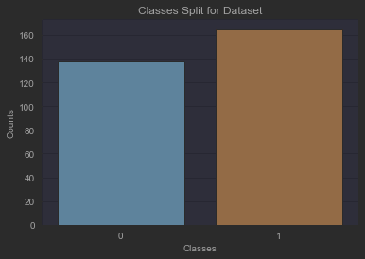
Exploratory Data Analysis
We found that there was a class imbalance, therefore we could use downsampling methods, upsampling methods, or SMOTE to balance the classes

Slide 8
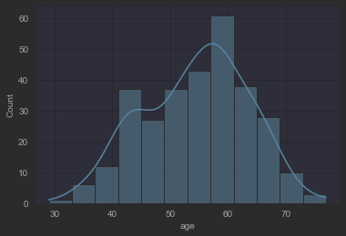
Exploratory Data Analysis
We can observe that the dataset has more or less a uniform distribution, however it can also seem like it is bimodal.

Slide 9
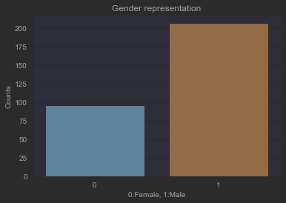
Exploratory Data Analysis
It would seem as there are more males than females in the dataset. Males had a 68.32% representation whereas females only had 31.68% representation.

Slide 10
Preparing the Data
Checked dataset for missing values: none found
Checked dataset for duplicates: found one duplicate row
Dropped duplicate row to address duplication problem
Scaled columns with continuous variables: 'age', 'trestbps', 'chol', 'thalach', 'oldpeak'
Dropped the same columns when encoding categorical columns using pandas' getdummies function
Concatenated scaled and encoded dataframes to get a complete dataframe
Checked for class imbalance in the data
Found significant class imbalance between individuals with and without heart disease
Used SMOTE to balance classes within the dataset

Slide 11
Data Visualizations
Bar plots help understand data distribution
Bar plot of gender attribute showed males accounted for 68.32%, while females accounted for 31.68% of the distribution
Ideally, gender distribution should have equal representation of classes
Crosstab function used to understand relationship between age and target variable
Crosstab function revealed that people aged 54 suffered most from heart disease
People aged 41, 51, and 52 were equally vulnerable to heart disease
People aged 58 were among those that did not suffer from heart disease

Slide 12
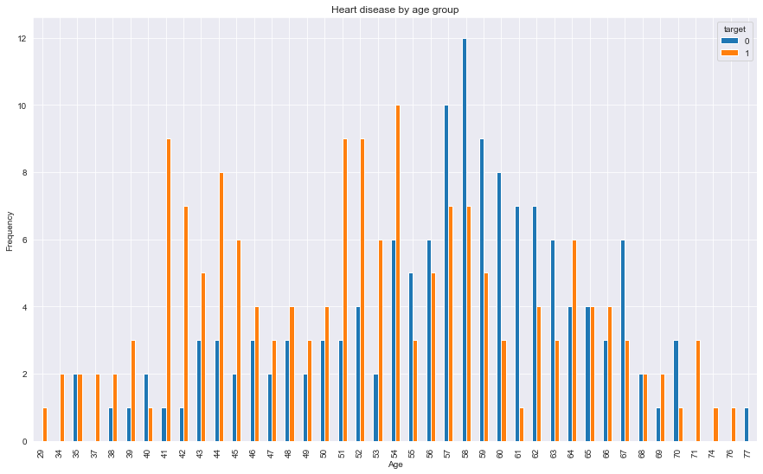
Data Visualizations

Slide 13
Data Visualizations
Heat map used to understand attribute correlation
Color map used: blue to red
Blue represents positive correlation, red represents negative correlation
Target positively correlated with thalach, but not strongly (values not close to 1)
Strong negative correlation between slope and oldpeak
Target negatively correlated with oldpeak and exang
Diagonal line represents correlation for variable with itself, so it shows as 1.

Slide 14
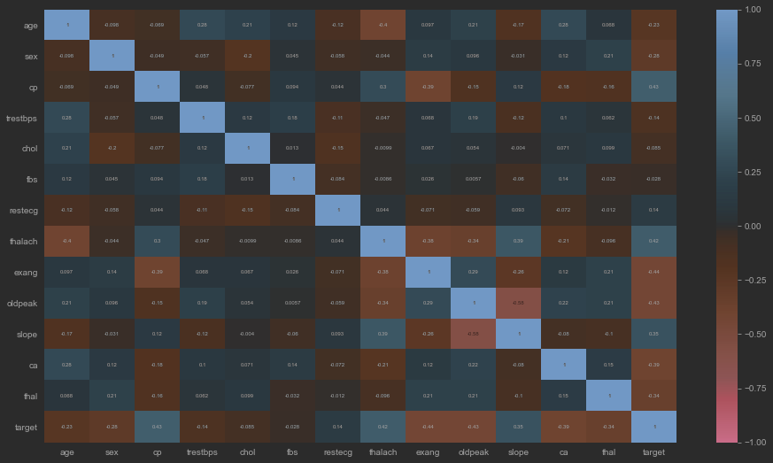
Data Visualizations

Slide 15
Model Building and Evaluating Algorithms
Before building machine learning models, dataset split into train, test, and validation sets
Split percentages: train 60%, test 20%, validate 20%
Train set used to train models
Test set used to improve model performance using hyperparameters and regularization
Validation set is a hold-out set used only to test final model performance
Purpose of validation set is to evaluate models

Slide 16
Model 1: RandomForest
First model built was random forest, which is an ensemble of decision trees
Random forest is a supervised machine learning model
Model trained without hyperparameter tuning to provide baseline for comparison
Default values specified in scikit library used for first training
Default max_depth can lead to overfitting and should be avoided
Model used to predict on test set, accuracy score measured at 84%

Slide 17
Model 1: RandomForest
Model optimized further using hyperparameter tuning techniques, like RandomizedGridSearchCV
Hyperparameters randomly selected from specified range of values
Model trained again and used to make predictions on test set, scoring 81%
Drop in accuracy score reflects overfitting in first training without hyperparameter tuning
True score of random forest after tuning hyperparameters is 81%
Randomized search means accuracy score will differ each time algorithm is run
Model tested on hold-out validation set, scored 80% on accuracy (not far from 81% on test set)

Slide 18
Model 2: K Nearest Neighbors
K nearest neighbors is a non-parametric supervised learning algorithm.
It works by memorizing the training data and classifies new data points based on their proximity to existing data points.
The model was trained on the train set and tested on the test set, resulting in a preliminary accuracy score of 80%.
A RandomizedSearchCV was used to determine the best hyperparameters, which improved the accuracy score to 83%.
The model was finally tested on the hold out validation set and scored 77% in accuracy, indicating that it may not be the best model for further predictions.

Slide 19
Model 3: Support Vector Classifier
Support vector classifiers use support vector machines to find the best boundary between two classes of data.
The default parameters were used to train the model, and it scored 85% on the first attempt.
Hyperparameter tuning using RandomizedGridSearchCV did not improve the model's accuracy, which stayed consistent at 85%.
The model was tested on a holdout validation set, and its accuracy dropped to 83%, but this is still a good result because the model performed well on the training and test sets and was able to generalize well to new and unseen data.

Slide 20
Model 4: Voting Ensemble
A Voting Ensemble is a machine learning technique that combines multiple individual classifiers to make a prediction.
In a Voting Ensemble, each individual classifier makes a prediction, and the final prediction is determined by combining the predictions of all the classifiers.
Hard voting was used in this model, which means the model picks the majority vote of the predictions made by individual classifiers.
Three models were chosen for the ensemble: a decision tree, linear regression, and ada boost classifier, with individual accuracy scores of 74%, 80%, and 79% respectively.
The model was tested on the hold out validation set and it scored 80%.

Slide 21
Model 5: Neural Network
A sequential neural network with 3 layers was trained on the training data.
The loss and accuracy of the model during training were 1.39 and 85%, respectively.
Two more layers were added to the model, with different numbers of nodes and activation functions.
Dropout regularization was applied after the second, third, and fourth layers with a rate of 0.5 to prevent overfitting.
The model was compiled with the binary cross-entropy loss function, the Adam optimizer, and accuracy as the evaluation metric.
The model was trained for 200 epochs with a batch size of 16 and validated on the test data after each epoch to monitor its performance on unseen data.
The model was tested on the hold out validation set and scored an accuracy of 81% by converting probabilities to either 0 or 1 using a threshold of 0.50.

Slide 22
Business Insight
The heartdataset.csv models can be important for an insurance business because they can help in accurately predicting whether an individual has a heart disease or not based on their attributes.
Accurate prediction of heart disease can help insurance companies to better understand the risk profile of their customers, and thus set more appropriate insurance rates.
The models can also be used to identify individuals who are at high risk of developing heart disease and recommend preventive measures, which can help reduce the number of insurance claims related to heart disease.
By incorporating the heartdataset.csv models into their risk assessment process, insurance companies can improve their accuracy and reduce their exposure to risk.
Ultimately, this can lead to a more profitable insurance business with lower costs and higher revenues, while also benefiting the customers who receive more personalized and appropriate insurance rates.

Slide 23
Conclusion
Support vector classifier had the best performance among all the models.
It achieved an accuracy score of 83%.
The model performed well on the training and test sets.
It also generalized well to a new hold-out validation set.
This model will help in accurate prediction of heart disease based on given attributes.

